Slide 1

Andrew Leung
International Consultants & Investments
A 10- Point Multimedia
Outlook on Life
Andrew K P Leung, SBS, FRSA
International and Independent China Strategist

Slide 2
Disclaimer
All materials contained in this presentation, including any analysis, comments, remarks, opinions and pointers are for information, debate and discussions ONLY. No warranty of their accuracy, completeness, timeliness or reliability is implied.
Any reliance on these materials in any way assumes total exemption of any liability whatsoever of Andrew Leung International Consultants and Investments Limited and Andrew K P Leung including all their current and future Affiliates, Associates or Assigns.

Slide 3

1. Life is Multifaceted and as Rich as you make it; but First Things First

Slide 4

2. CRYSTALIZE, SIMPLIFY, PRIORITIZE, and EMPHATHIZE
Notes:
Y,

Slide 5

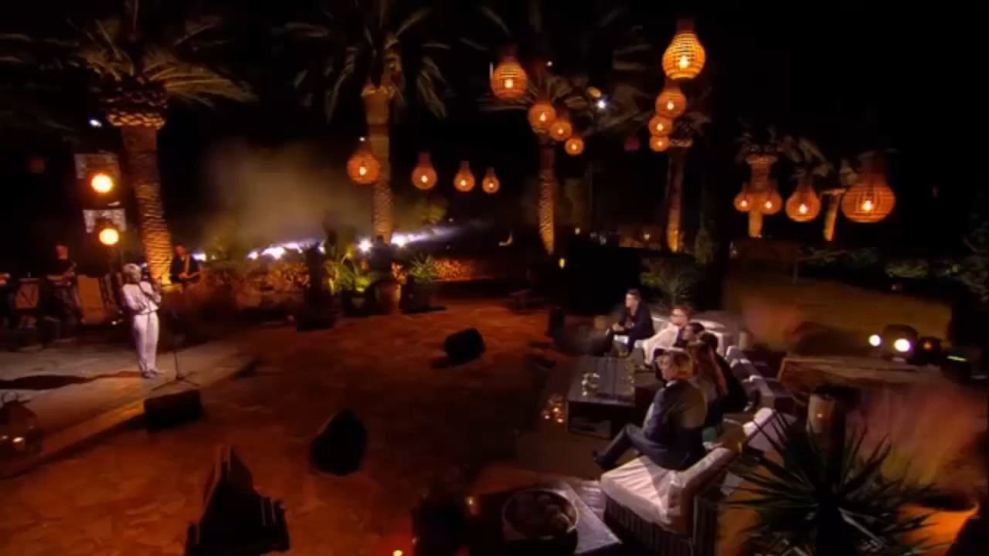
3. Find your Passion. Follow your Dreams. Your Moment will come!

Slide 6

4. Learn from the resilient adaptation of mountain goats
Through our life journeys, we also have to combine our heart, our mind, our will and our strength, like the sika deer’s legs and toes, in negotiating through treacherous passages. With well-seasoned confidence, wisdom, courage, action, and a virtuous character, we are well-positioned to scale challenging heights in reaping a life of abundance.

Slide 7

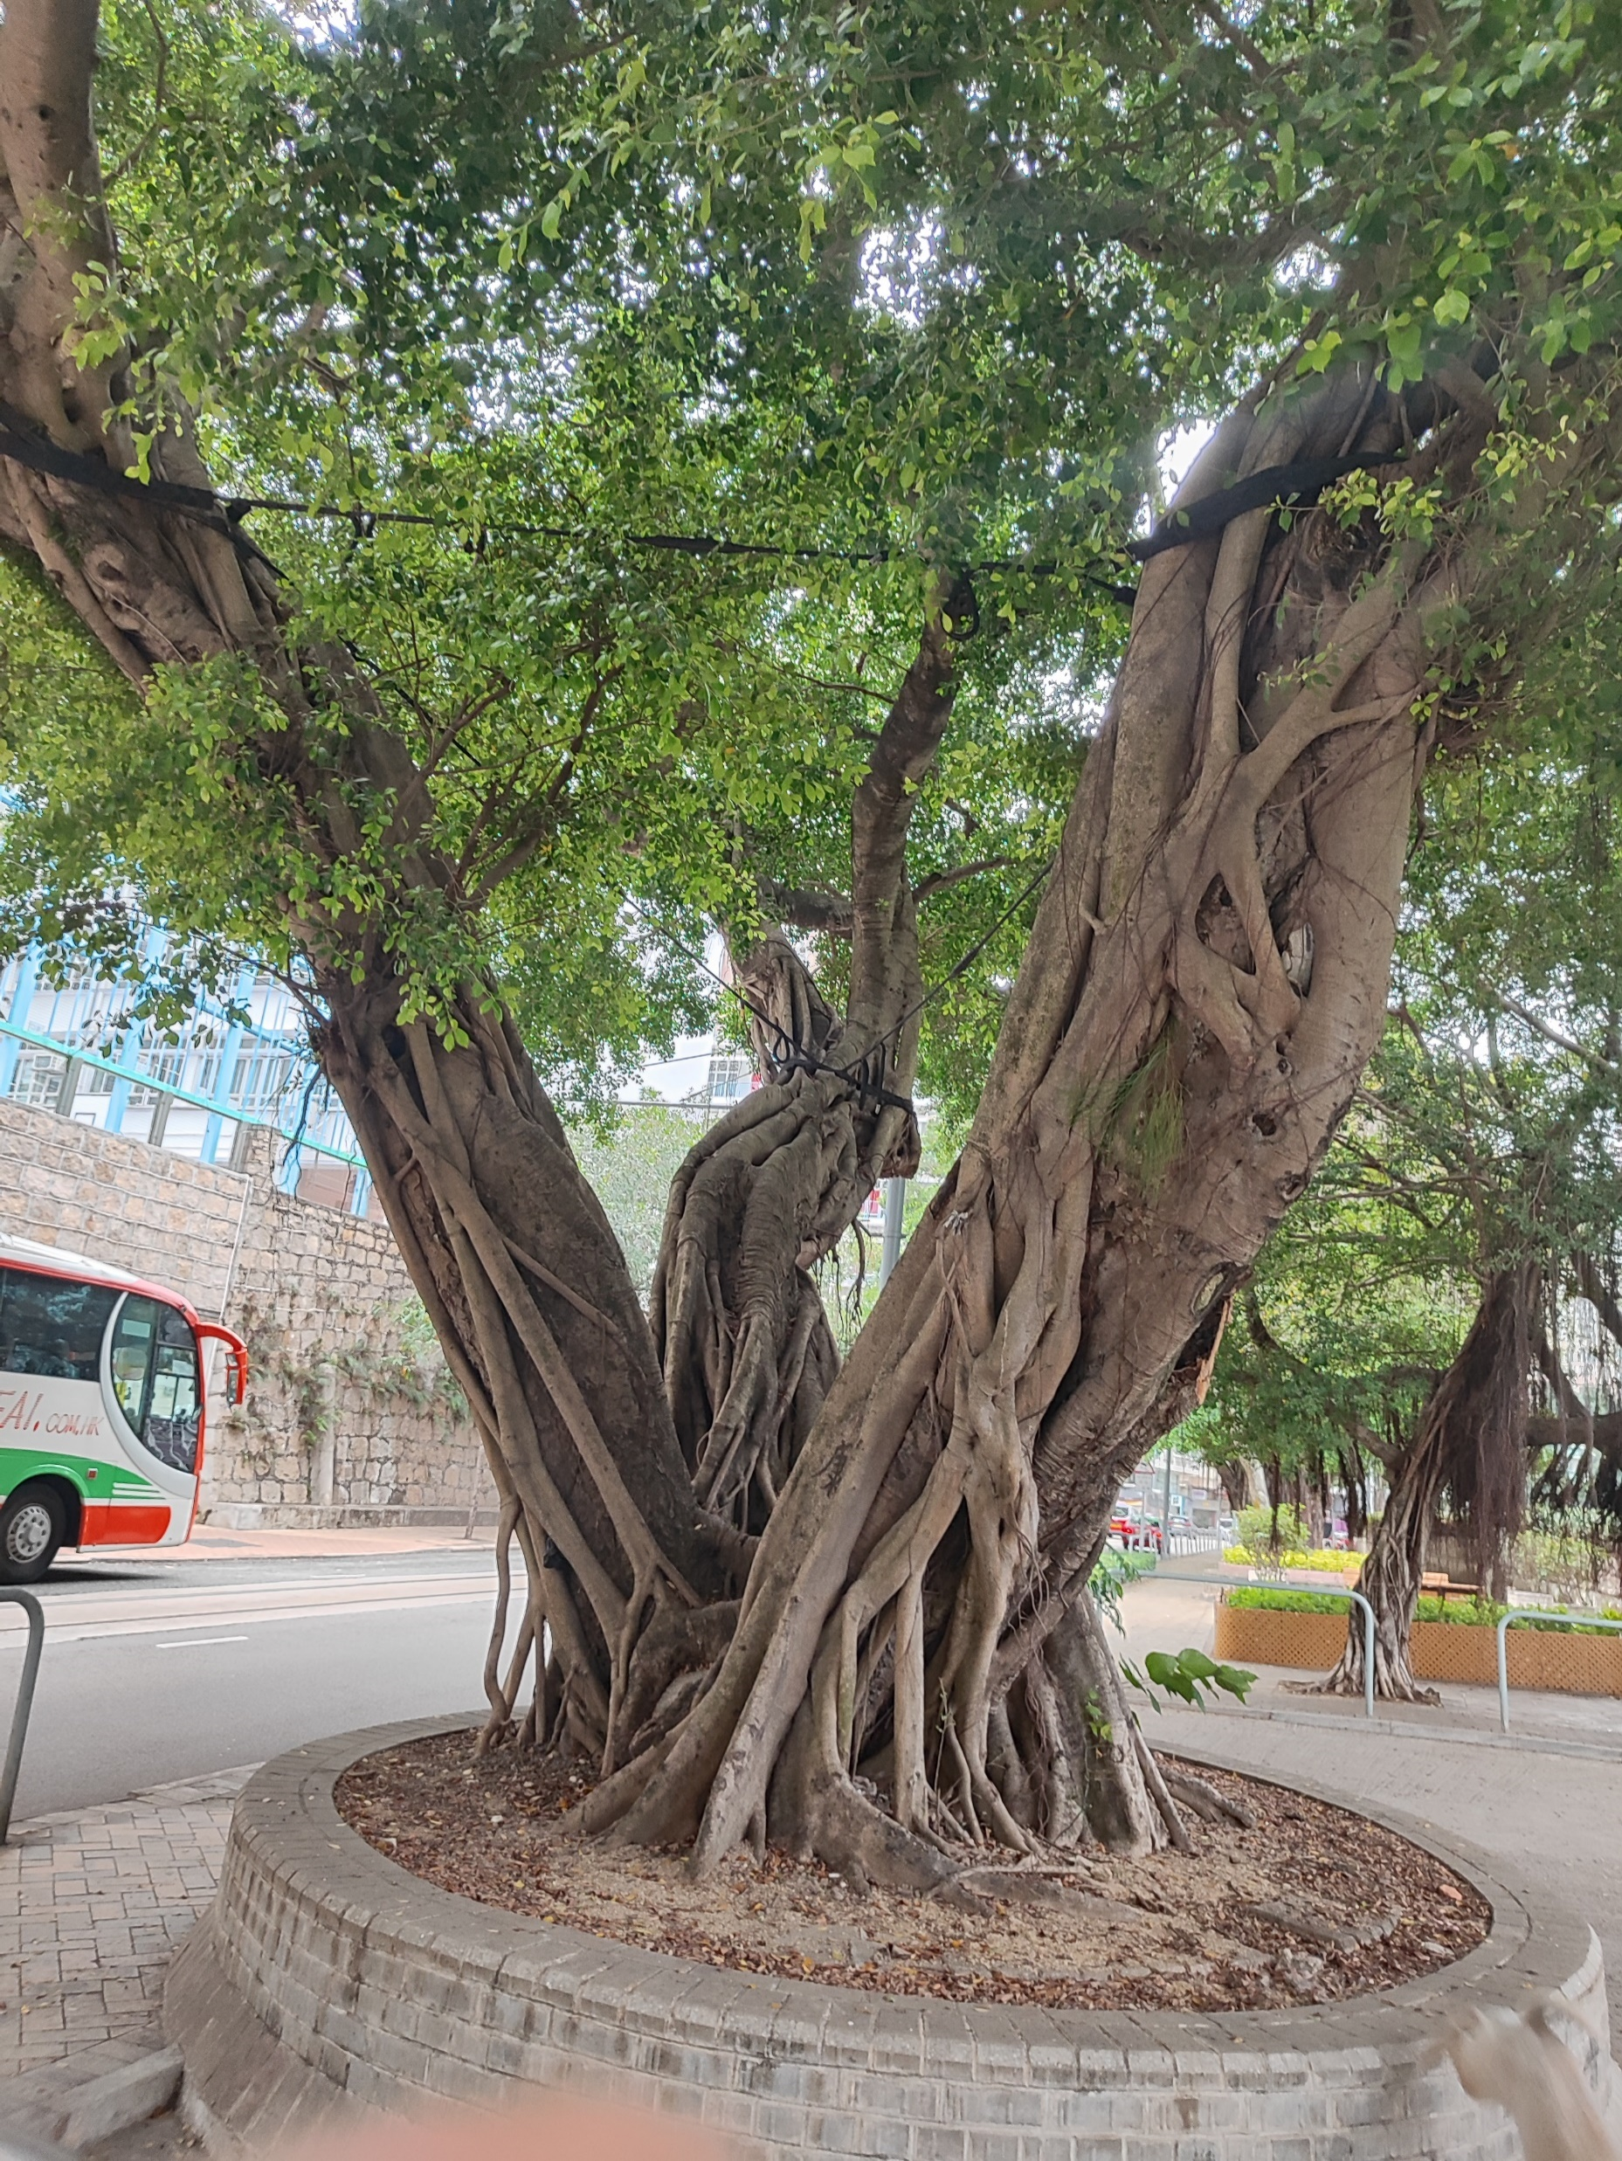
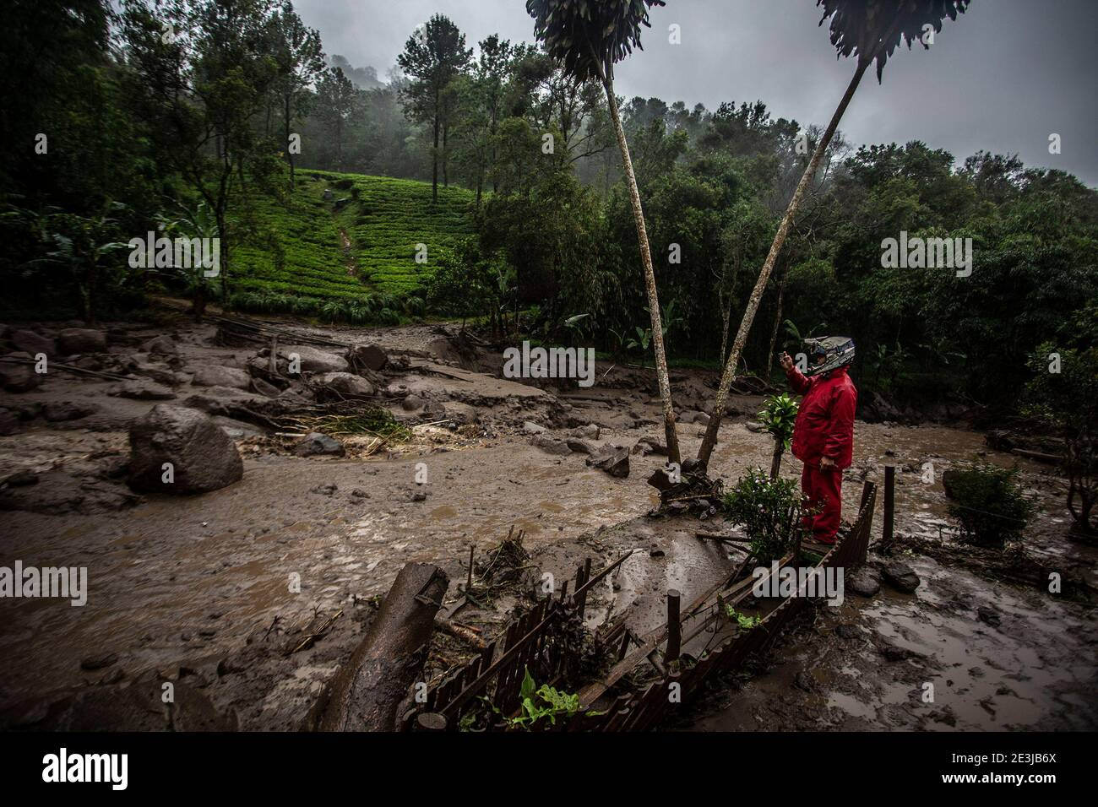
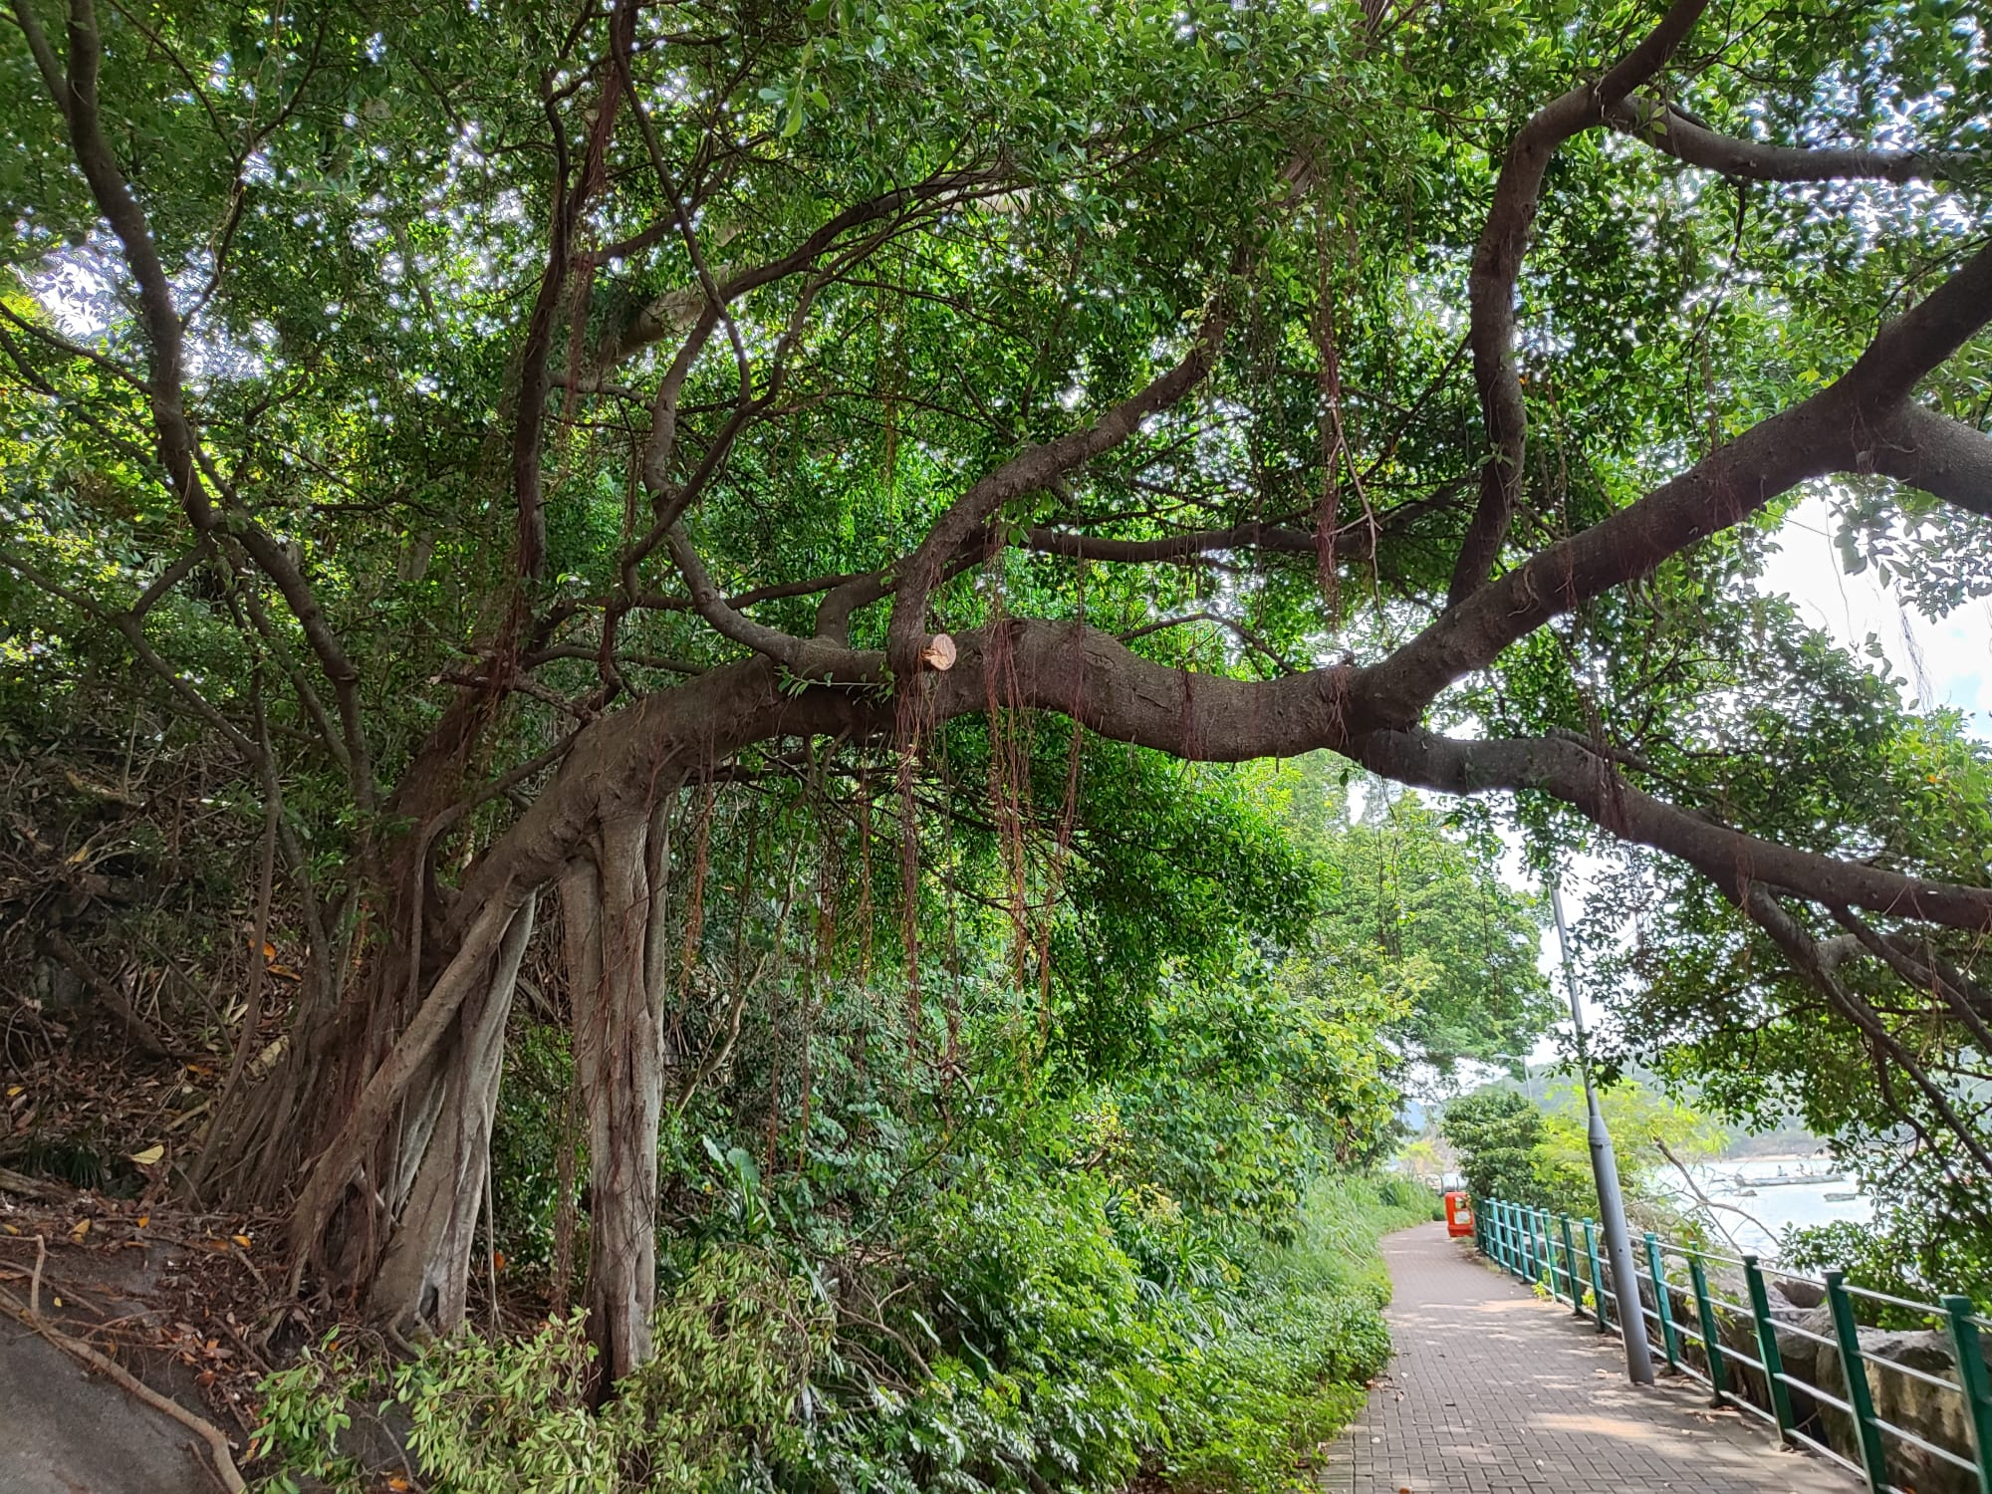
5. Build strong roots through weather-beaten hardship
Indonesia’s Bogor Botanical Gardens
blessed with rich volcanic soil
Three-in-one tree in Happy Valley,
Hong Kong
Extra-strong supporting roots, Repulse Bay, Hong Kong
But plants ill-fitted against heavy storms

Slide 8
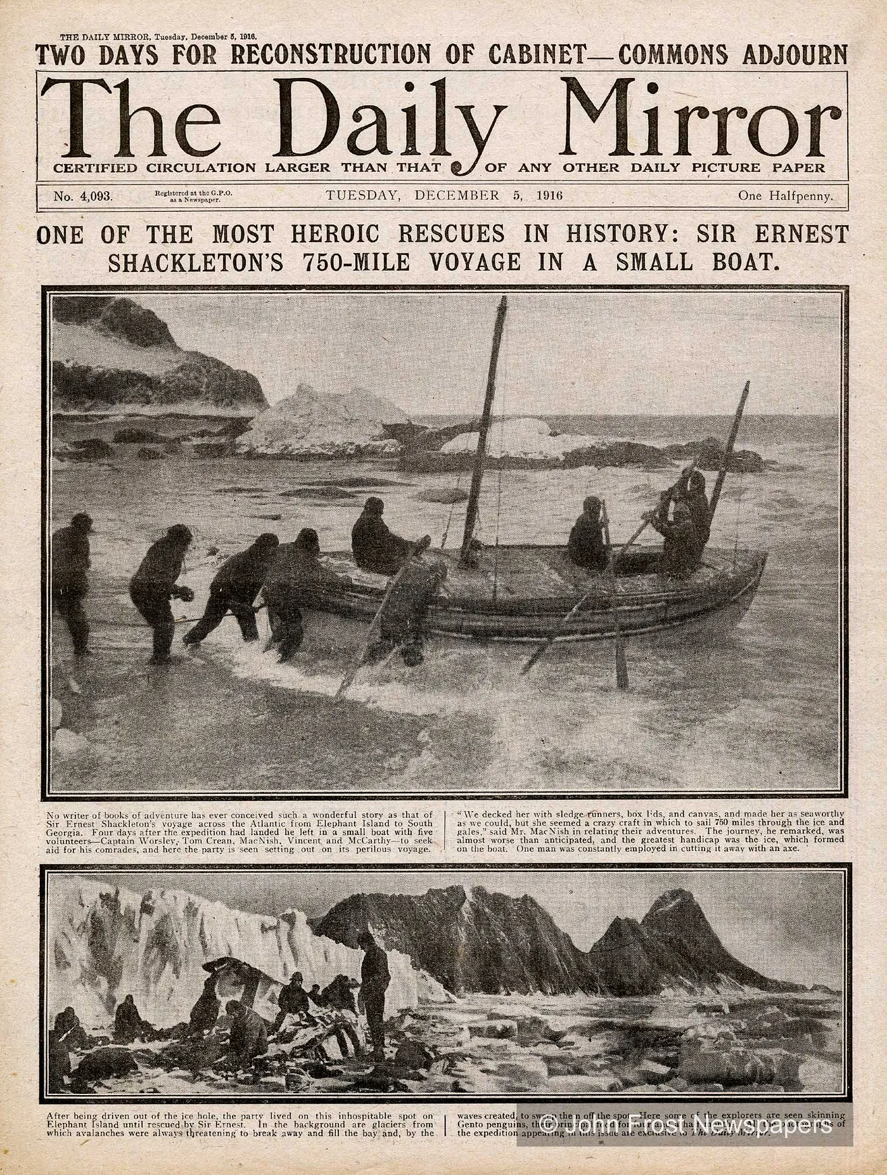
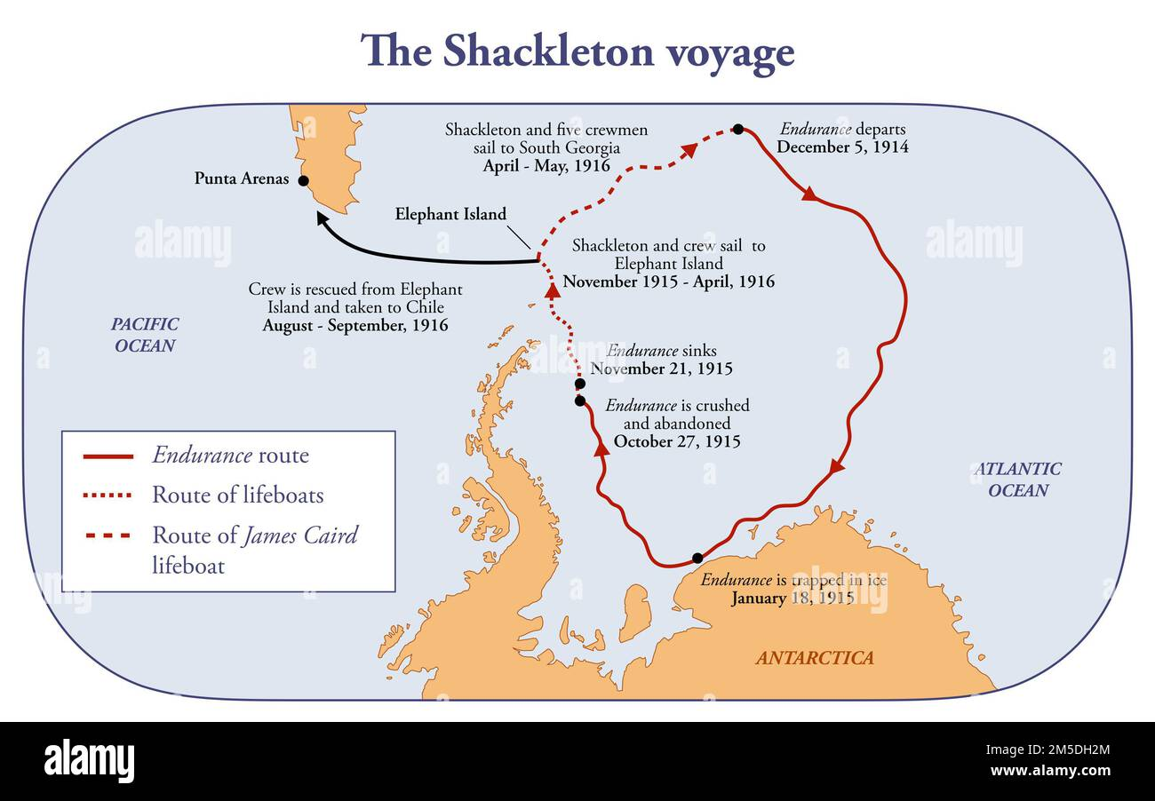
6. Lessons from Shackleton – Never give up! Be always fully prepared!
Venturing out for help, Shackleton undertook to return to pick up his marooned crew on Elephant Island the following spring. When spring came, however, ice sheets kept the sea frozen, blocking his passage. After waiting for days, a thawing occurred, allowing a very narrow creek for his ship to pass. On arrival at Elephant Island, he saw in the distance that his comrades were already fully packed and waiting on the shore. Without a single moment of delay, they quickly boarded the ship and commenced their return journey. After an hour, the creek got frozen up again. Shackleton asked his comrades how they managed to identify this rare moment of possible passage and got ready for the pickup. They replied that without fail, they got fully ready every day for over half a month in the firm belief that the promised pickup will happen someday. In our daily lives, when a rare and limited opportunity occurs, are our knowledge, abilities and health remain fully prepared to seize the moment?

Slide 9
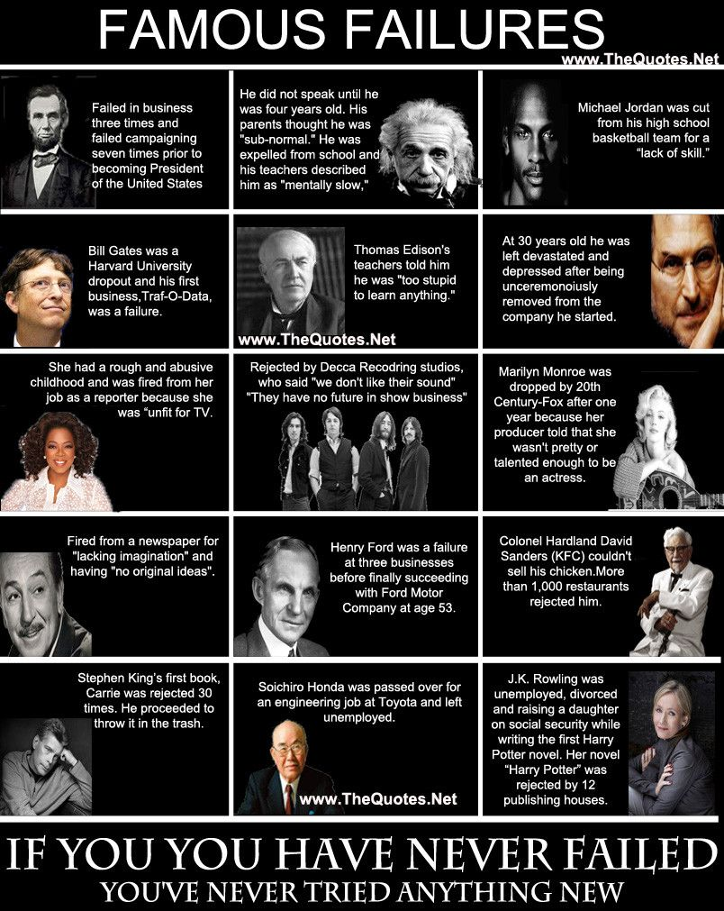
7. Never too late! Take failures for granted!

Slide 10
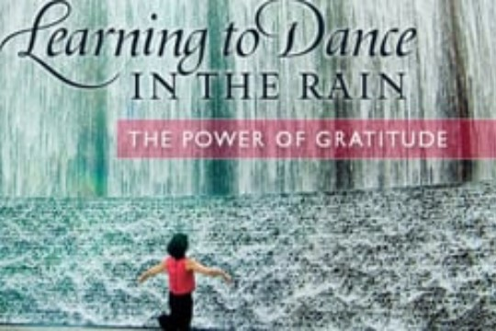
8. Dance in the Rain

Slide 11

9. Enjoy Nature’s abundance

Slide 12
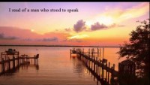
10. What Matters in the End

Slide 13
Andrew Leung
International Consultants & Investments
Thank you
Andrew K P Leung, SBS, FRSA www.andrewleunginternationalconsultants.com
Prominent international and independent China Strategist. Over 40 years’ experience in senior Hong Kong Government positions. China Futures Fellow, Massachusetts Berkshire Publishing Group; Brain Trust Member, IMD Lausanne Evian Group; Gerson Lehrman Group Council Member; Thomas Reuters Expert; Senior Analyst with Wikistrat. Elected Member, Royal Society for Asian Affairs. Advisory Board Member, e-Centre, European Centre for e-Commerce and Internet Law. Think-tank Research Fellow, Beijing Normal University, Zhuhai Campus. Visiting Professor, London Metropolitan University Business School. Honorary President, China Hong Kong Economic and Trading International Association. Formerly Governing Council Member, King's College London; Advisory Board Member, China Policy Institute of Nottingham University; Visiting Professor, Sun Yat-sen University Business School (2005-10). In the 1980s, oversaw Hong Kong’s industrial transmigration into Mainland China and helped launched Quality Campaign and Technology Centre. Invited by US government to month-long visit to brief Fortune 50 CEOs personally, including one-on-one with Steve Forbes of Forbes Magazine, on China post-1989. In 2002, invited by Prince Andrew for a private briefing leading to HRH’s first visit to China as UK’s Ambassador for Trade and Investment. Advised on cross-cultural management in Lenovo's take-over of IBM Computers. Invited as Editor-at-large for an international consultancy on China's energies. Regular contributor, commentator, and speaker on China at conferences and on live television worldwide including National Geographic. Topics include trade, finance, economics, geopolitics, international relations, science and technology, sustainable industrial development, and green cities. Graduate qualifications from University of London, postgraduate qualifications from Cambridge University, PMD from the Harvard Business School, and solicitors' qualifying examination certificate from the Law Society, London. Included in UK's Who's Who since 2002. Awarded Silver Bauhinia Star (SBS) in July 2005 Hong Kong Honors List.

